Slide 1



Welcome to Year 1
St James’ Church of England Primary Academy

Slide 2
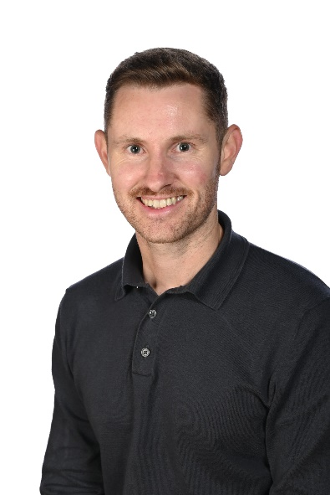
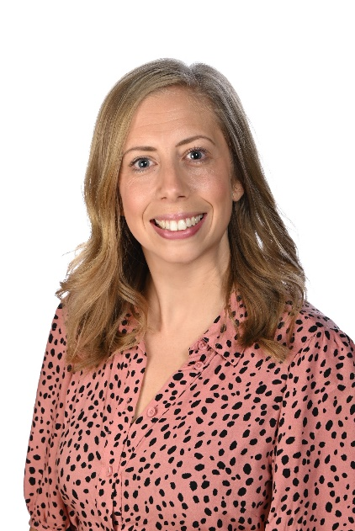
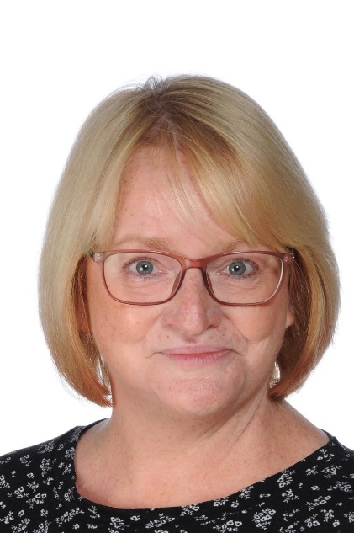
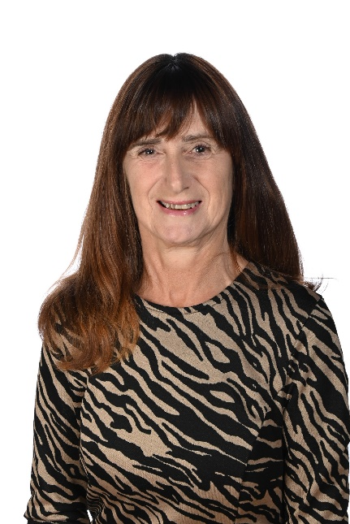
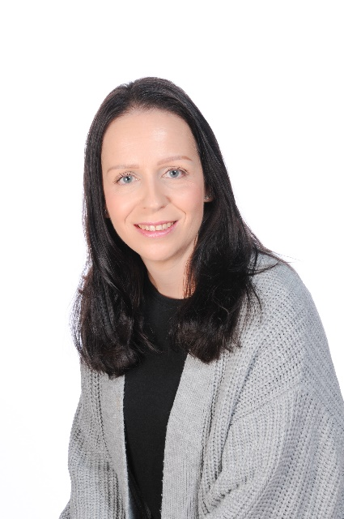
Introductions
Mr Parsons
Mrs Stoodley
Mrs Argent
Mrs Chadd
Mrs Norman

Slide 3
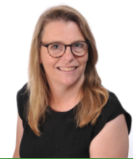
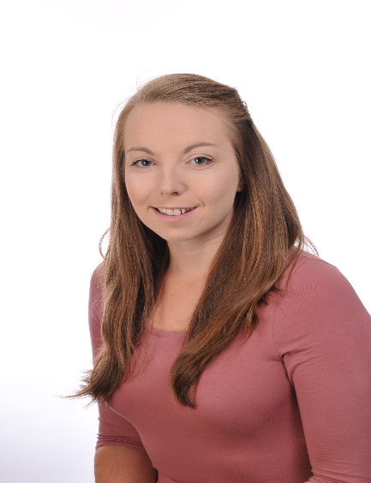
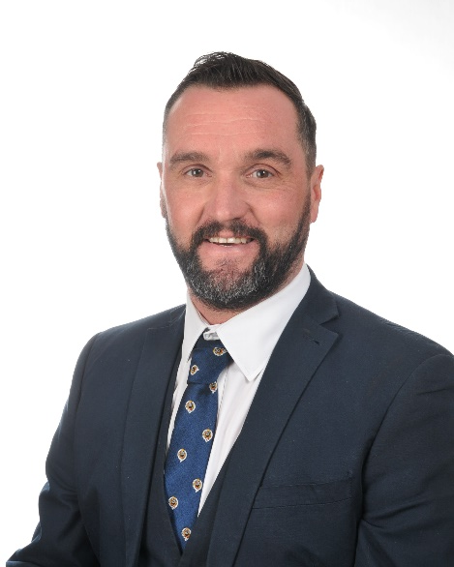
Also…
Mr Brown
Headteacher
Mrs Dodd
Deputy Headteacher
Mrs Price
Inclusion Leader
Mrs Dodd is our Designated Safeguarding Lead
Mr Brown and Mrs Price are also part of the designated safeguarding team – if you have any concerns about child welfare you should speak with them in the first instance.

Slide 4
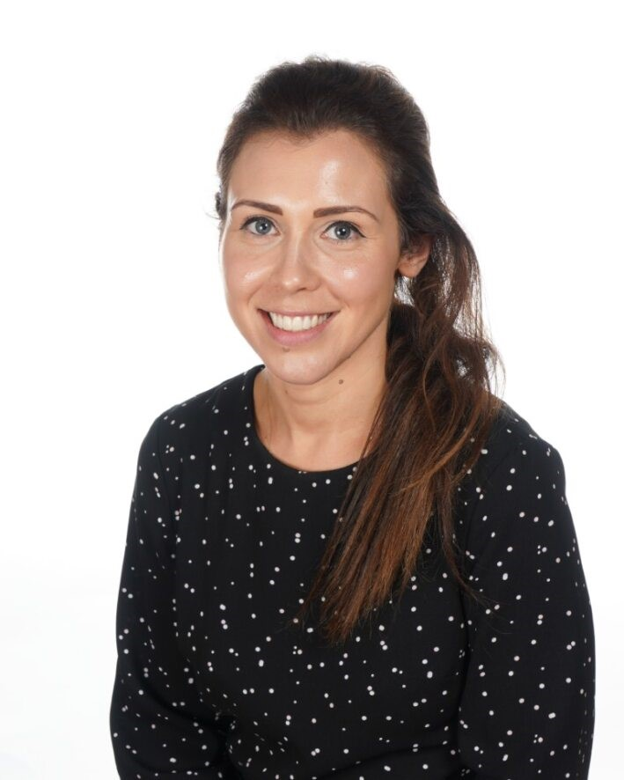
Family Support Worker
Mrs Leslie
Family Support Worker
Mrs Leslie works in partnership between the school and parents/ families. She increases our pastoral care provision, focuses on attendance and provides direct support to families at times of need. You will often see her standing by the front school gate in the morning, if you want to chat or arrange an appointment.

Slide 5

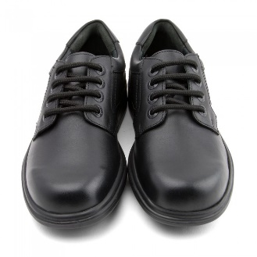


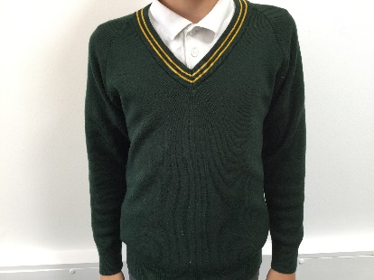
Uniform
Uniform – Uniform policy to be followed. Information on the school website. This also applies to P.E. kit. This is important because it gives all children a shared identity, an equal sense of belonging and does not make children feel ‘different’. We expect our children to be smart and ready to learn.
Summer and Winter uniform – as appropriate to the weather
No fancy hair ornaments are permitted.
Hair slides or bands should be brown, black or school colours
Black, sturdy, practical school shoes
(boots, trainers or high–heeled shoes are not permitted)
Hoodies/ Jumpers can not be a replacement for a waterproof coat or our school uniform
School Jumper
Waterproof Coat with hood

Slide 6


Attendance
Being in school is important to your child’s academic achievement, wellbeing, and wider development. There is evidence to suggest that regular school attendance is a key mechanism to support children and young people's educational, economic and social outcomes.
Data from 2019 shows that 84% of Key Stage 2 pupils who had 100% attendance achieved the expected standard, compared to 40% of pupils who were persistently absent across the key stage.
If your child is worried about coming to school, please TALK to us. We want to support them to enjoy coming to school.
New government guidance means that 10 unauthorised absences ( 2 per day) in any 10 week period
is likely to mean a fine of £80 per parent per child. This includes being late!!

Slide 7

Important St. James’ information
Get the App!!
It’s free and you can sign forms for permission online etc. You can also use it to pay for things online.
Password problems etc. please come and ask the office for assistance

Slide 8

Ready, Respectful, Safe
We want all of our children to flourish and thrive and our behaviour policy is built around being ready, respectful and safe in all that we do.

Slide 9

Rewards
We believe in positive praise and encouragement :
RRS postcards home
House points
Gold tokens
Class cup (given on a Friday- tie can be worn on the following week and to be returned by Wednesday)
We also have a class bear that comes home every Friday and comes back by Wednesday
Boats- Superb Stours and Brilliant Bournes

Slide 10
Timetable information
PE is on a Thursday - children to come to school dressed in PE kit every Thursday.
A typical day…
Worship
Maths
Break
Phonics
English
Lunch
Science
History
Whole Class Reading
Hometime
Other subjects:
Art
DT
PSHCE
Music
French
Computing
Handwriting

Slide 11
Our Year ahead…
Term 1
Friends, Families and Fantastic Bodies
- Looking at the body and the senses
- Learning about what makes a family and learning about different family types
Term 2
A Walk in the Park
Trip to local park to see seasonal changes (volunteers will be needed!)
Looking at the weather and local area

Slide 12
Our Year ahead…
Term 3
Explorers Assemble!
Amy Johnson (first lady to fly solo From England to Australia)
Geography – identifying UK countries and capital cities
Term 4
Dynamic Den-gineers!
Everyday materials and their properties, investigations
The Three Little Pigs- building a new house for them to keep safe from the big bad wolf!

Slide 13
Our Year ahead…
Term 5
Curious Creatures!
- Science – Animals, including humans
- Geography – (Human and physical features of) Hot and cold areas (links with science to animal habitats) including seasonal and daily weather patterns
Possible creature visitor experience
Term 6
Oh I do Like to be beside the Seaside
-History – Changes in the seaside/Bournemouth over time and Mary Anning (historical fossil hunter!)
Trip to the beach! (Volunteers needed!)

Slide 14







Reading
We want a school full of enthusiastic lovers of reading!
Your child now has a reading diary and a book. Please keep the reading book in their bag each day so that we can read with the children in school.
We have a class reading area in each classroom
Library time is on a Thursday afternoon- children can choose a book to bring home and change it weekly if wanted.
Reading raffle – 3 for 1, 5 for 2 (Books and Biscuits reward)
Recommended reads – new books/classics/chapter books/non- fiction/poetry
https://www.booksfortopics.com/booklists/recommended-reads/year-1/

Slide 15
Phonics
In Year 1, we continue to have Phonics lessons daily. We will begin to learn new sounds from next week.
Up to now children have learnt one way of representing (spelling) each sound/phoneme in the English language.
This year we begin to learn alternative ways to spell phonemes (sounds they know and later in the year alternative ways to pronounce letters they are familiar with.
At Home
We will let you know on our webpage each week what we are learning in phonics. A parent information link will be on the website each week.
Word walls

Slide 16
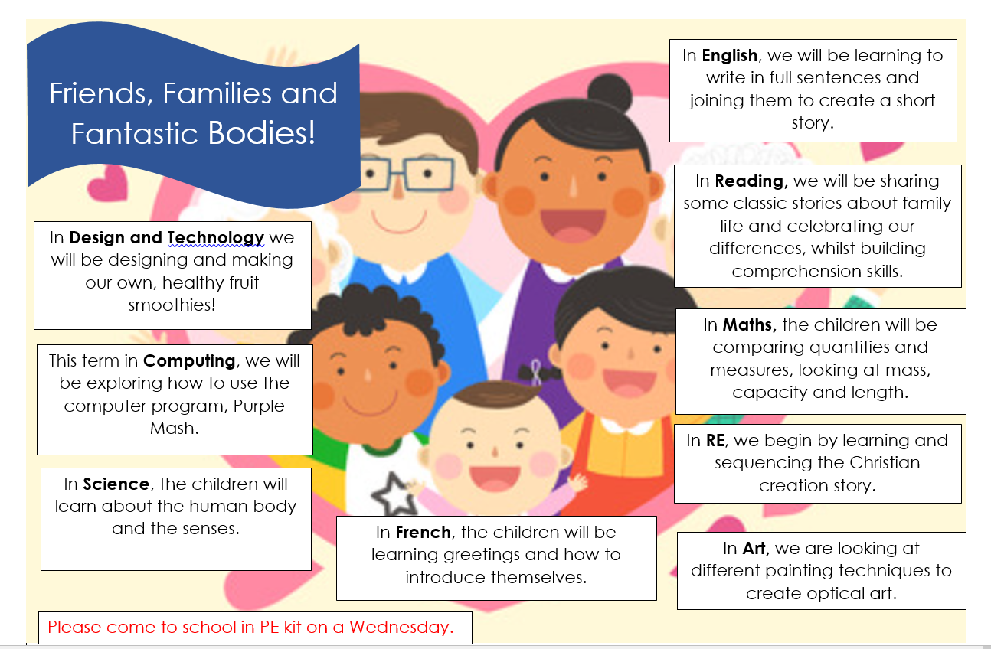
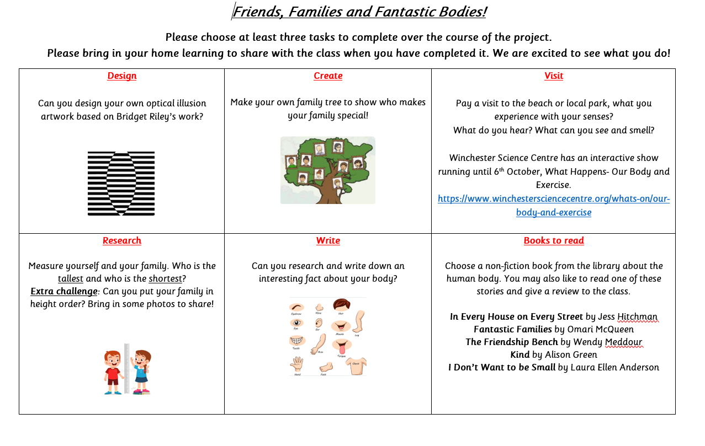
Homework
Each half term a parent information letter and a curriculum map will be added to the website and a paper copy brought home. On there will be home learning we suggest would be lovely for you to do with your child at home to extend their learning throughout the project.

Slide 17

Numbots
Your child will be given a login that will be stuck onto the front page of their diaries.
Daily practice of numbers will help with their confidence and understanding.
Look out on the website for when these logins will be ready but all the instructions will come home in your child's bag.
https://youtu.be/5EdGOYu5zMw

Slide 18

My Maths
My Maths is another online platform which will help your child’s maths learning.
We will set pieces of online learning for your child to complete based on what they have been learning in school.
Logins will be sent home soon.

Slide 19
Lunch boxes, snacks etc.
We have a no nuts policy. Please respect this for the safety of all children.
Healthy and balanced diet.
Drinks – no fizzy. Bottles named.
Water bottles for the classroom but, again, must be named. It is helpful for children with lunchboxes to have a separate drink for their lunchbox if possible.
Water only in the water bottles, no squash/flavoured water etc.
Snack – hand held healthy food e.g. fruit or cereal bar.

Slide 20

Website Information and Overview
Last year we got a shiny new website! It is very user friendly and easily accessible on a mobile phone.

Slide 21
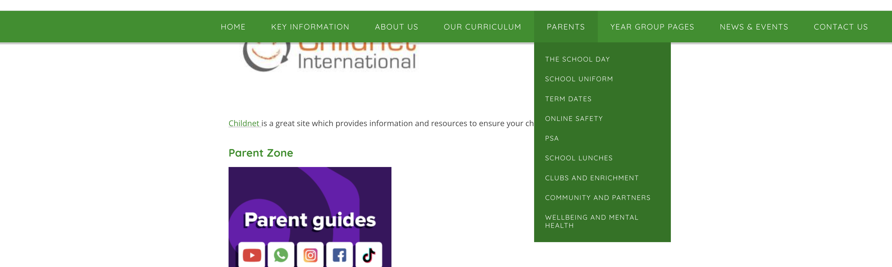


Online Safety
Keeping children safe online is crucial. Please take a look on our website where we will try to update you on the latest websites and worries to look out for.

Slide 22
Key dates
Harvest Festival – Thursday 2nd October
KS1 Harvest Festival service: 9am in church(parents welcome)
KS2 Harvest Festival service: 11am in church (parents welcome)
Fraser portraits – Monday 13th October, all children have individual picture taken
Open Morning - Saturday 8th November 10am – 12pm
Online Parents’ evenings – Wednesday 26th November 4.00pm - 7.00pm,
Thursday 27th November 3.30pm – 6pm
Christmas performances – week beginning 8th December. These are in the hall for Years R-4.
Sport's Day – Friday 19th June, 2026

Slide 23

If you need us…
If there is anything that you would like to ask the teachers, email the office, they will send the message through to us and we will reply back to you through the office.
Otherwise we are always approachable at the end of the day, once we have dismissed all the children, we are happy to see you and discuss anything you would like to.
Please bear with us at the end of the day, while we get to know parents faces.

Slide 24

We look forward to working in partnership with you, for all our children.
Thank you for coming along to the presentation.
Any Questions?

