Slide 1

Year 6 SATs Presentation 2025

Slide 2
Year 6 SATs Presentation 2025
‘ Practising the SATs made me feel more confident, prepared and under less pressure. I’m a worrier but it really helped that I knew what was coming.’ (Mollie, ex-pupil)
‘Getting better scores each time I practised made me believe in myself more.’ (Josie, ex-pupil)

Slide 3
Teaching Primary Mathematics for Mastery
The purpose of this afternoon:
Show you what the children will be tested on and when
Clarify our expectations and any statutory requirements
Tell you how we prepare the students
Suggest some ways that you can help to prepare your children

Slide 4
SATs…
Stands for ‘Standard Assessment Tests’
All Year 6 children across the UK complete them during the same week in May
Although not everyone agrees with SATs, we are obliged to conduct them
There are also many life skills that can be learned during this time

Slide 5
SATs Week – W/B Monday 12th May 2025
The children will complete the following assessments:
Monday: GPS – 45 Minutes plus a spelling test (not timed)
Tuesday: Reading – 1 hour
Wednesday: Maths paper 1 Arithmetic 30mins
Maths paper 2 Reasoning 1 – 40 mins
Thursday: Maths paper 3 Reasoning 2 – 40 mins
Friday: Beach day!

Slide 6
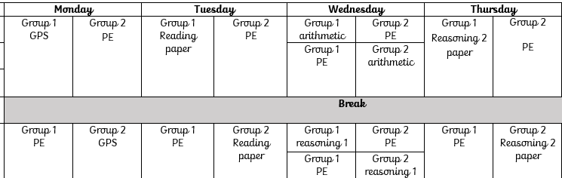
We split into two groups…

Slide 7
Maths Assessments
There are three parts to the maths assessment.
The former mental maths test has been replaced with an arithmetic assessment.
There are now two non-calculator reasoning papers to assess their ability to apply a range of mathematics in problem solving and word problem contexts.

Slide 8
The arithmetic paper
Tests children on their ability to solve number problems quickly and accurately.
The problems are purely number based (there are no words in the test).
There are 40 marks available.
The children have 30 minutes to complete approximately 35 questions.

Slide 9
The arithmetic paper
This test includes:
Multiplying and dividing by 10, 100 & 1000
The four operations with large numbers and decimals
Long division and long multiplication
Working out percentages of whole numbers
Adding, subtracting, multiplying and dividing fractions
Order of operations questions

Slide 10
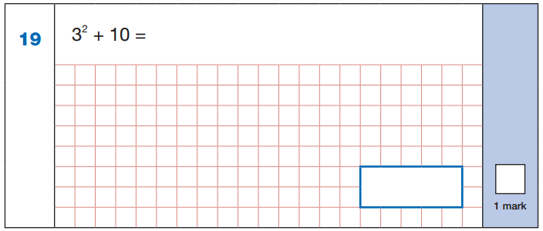
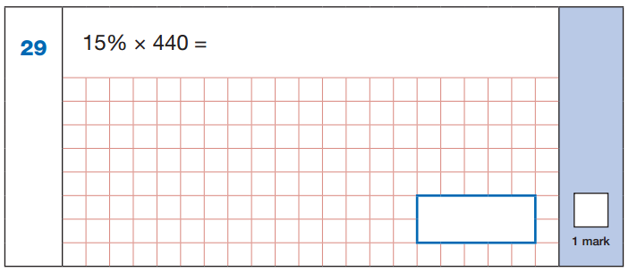
The arithmetic paper

Slide 11
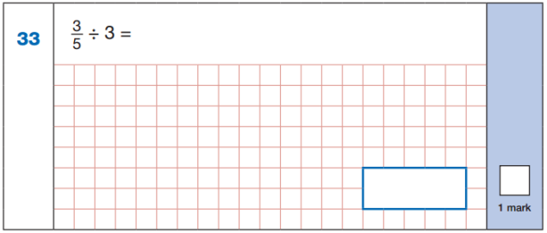
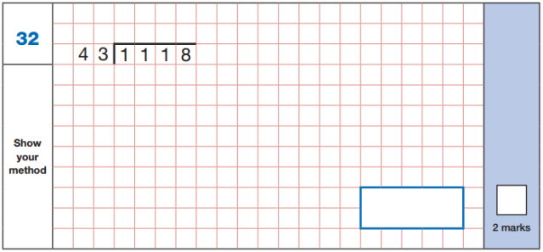
The arithmetic paper

Slide 12
The reasoning papers
These papers are designed to test the children’s knowledge of the primary maths curriculum and their depth of understanding in each concept.
The test includes questions based on problem solving, geometry, data handling, algebra, ratio, shape, space and measure.

Slide 13
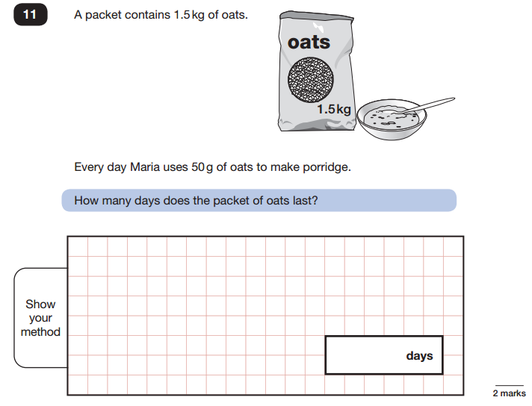
The reasoning papers

Slide 14
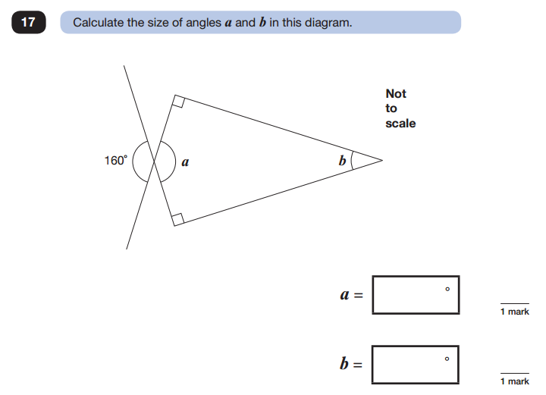
The reasoning papers

Slide 15
How to help with mathematics
Revise a variety of topics in the run up to the SATs – BBC KS2 Bitesize and Mathsisfun.com
CGP books
Bottom of Year 6 page on school website
Corbett Maths
Practise the four operations – repetition makes perfect
Fractions, decimals and percentages
Test children on their times tables
Prodigy game
Revision packs and activities on website

Slide 16
Reading Assessments
There is one paper during which they have an hour to read 3/4 texts and answer comprehension questions about each one.
There is a significant volume of text to get through.
The main focus of the test has shifted, with a greater emphasis on inference questions – a more complex skill.
Children will need to read quickly in order to complete the test in time.

Slide 17
How to help with reading:
Ask your children questions about a section of a book they have just read.
Expose them to different genres (including poetry).
‘Race’ your child to read a short section in a given time.
Help them scan for key words.
Explore unusual vocabulary – nothing is too tricky! As Dr Seuss said, ‘The more you know, the further you will go!’

Slide 18
Grammar, Punctuation and Spelling
This year the GPS test ( previously known as SPaG) will involve a 45 minute test and a spelling test
There will be 20 spellings which could be from the year 3, 4, 5 and 6 list or include any other ‘tricky’ spelling.

Slide 19
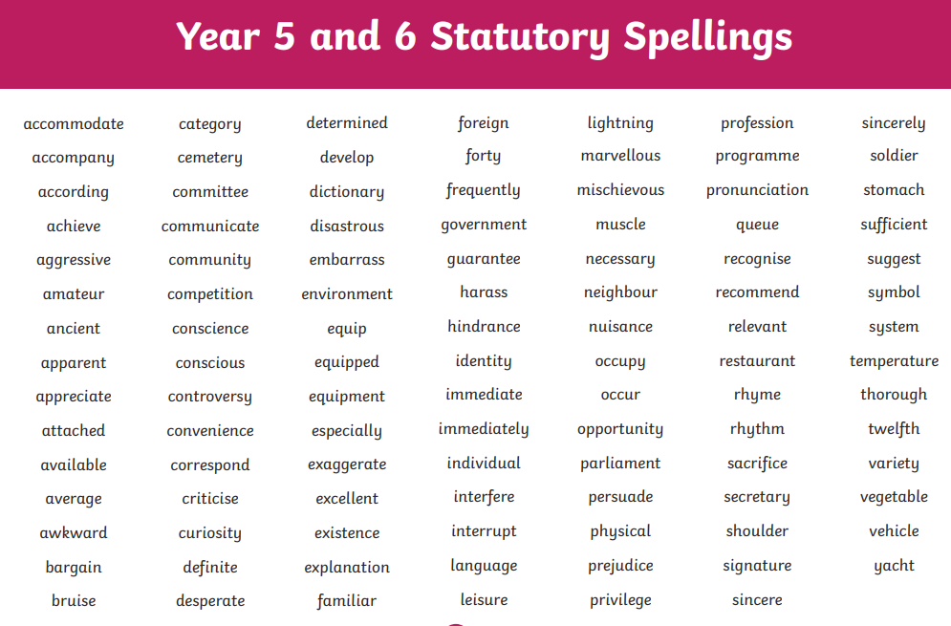

Slide 20
GPS – the types of questions…
Determiners
Relative clauses/relative pronouns
Modal verbs
Subjunctive form
Active/passive voice
Past progressive tense

Slide 21
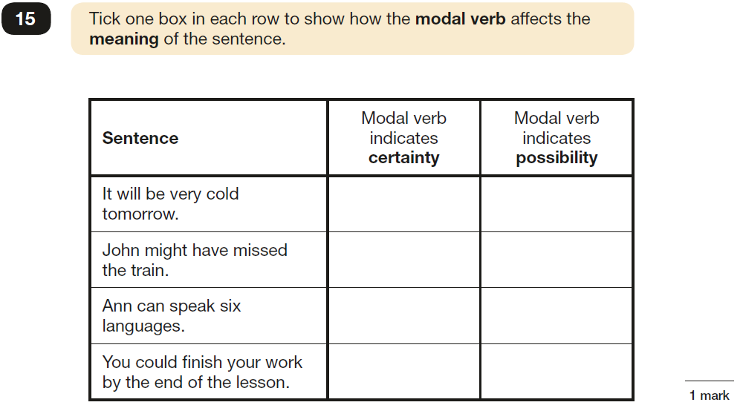
Modal Verbs – the possibilities are endless….

Slide 22
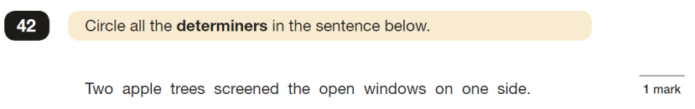
Determiners – they ‘pin’ down the noun!

Slide 23
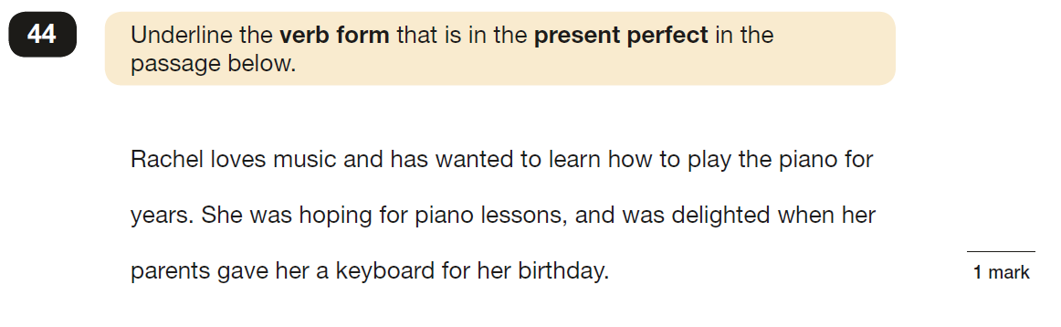
Present Perfect

Slide 24
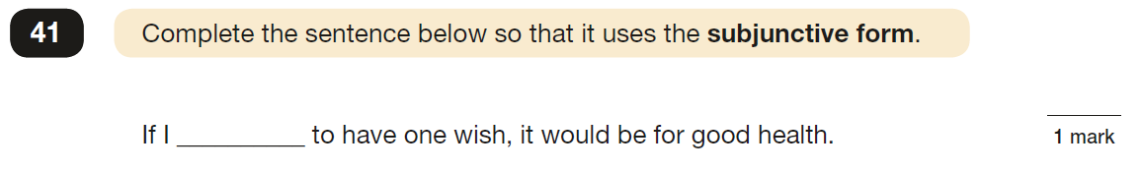
Subjunctive Form

Slide 25
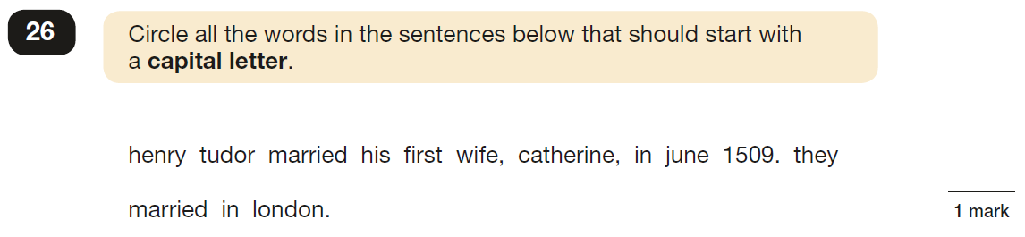
Checking answers…

Slide 26
Test Arrangements
We can read questions but children have to ask us! (Except for the reading test.)
Small groups
Small rooms
Familiar adults
Rest breaks

Slide 27
English writing
We will be assessing the children’s work across a range of written pieces.
In general, ALL of the requirements must be met to be age related
Handwriting matters.
Spelling and punctuation matters ( in the GPS test AND all writing).
Stamina and creativity counts.

Slide 28

It is tough this year but....

Slide 29
What we will do to help:
If you or your child are unsure about any concept, please ASK.
SATs hints booklets for Maths and GPS in the homework packs
Homework booklets
Tutoring
Drip feeding and practice!
Extra intervention sessions
PSHE lessons
Please, please try to ensure children are in school!

Slide 30
An emotionally healthy approach
Teaching children
Resilience
Independence
Pride in effort and achievement
Managing anxiety
Avoiding stress
Helpful websites:
www.YoungMinds.org.uk
http://www.studentminds.org.uk/examstress.html

Slide 31
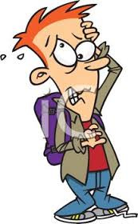
And please, please, don’t let your children (or you!) stress about it too much.
More than a score

Slide 32
SATs Week – little extras
Honestly, we see SATs week as a celebration. It is one of our favourite weeks of the year!
We try to make the week as relaxed and stress free as possible - we simply ask the children to show their very best.
We will be providing the children with a light breakfast and a glass of juice each morning.
Children will have plenty of break time after each test.
Weather permitting, we hope to take the children to the beach on Friday.

Slide 33
And finally…
‘St James’ Year 6 helped give me the skills I needed for secondary school. Practising for the SATs made me feel confident and ready. I am really proud of my SATs and it really helps me when I tackle all my tests at my new school.’ (Leah, past pupil)
‘St James’ did everything right!’ (Dan, past pupil)

Slide 34
Any questions?

